Slide 1
.NET Technology
C# (after JAVA)
https://www.theurlist.com/howest_ti_dotnet_csharpafterjava

Slide 2

You want to start from the beginning?

Slide 3

Content
Your first C# program
Data Types/Discard
Variable Declarations
Automatic Properties
Object/Collection Initializer
Primary Constructors
OOP in C#
Generic Collections
Nullable types/
Null Coalescing
String Interpolation
Expression bodied Members
Enumerations
Local functions
Switch Expressions
Deconstruction

Slide 4
C# - Java
A lot in common
Both langauges are fully OOP and share the same C like syntax
In this course
  Some C# syntax as an addition to your Java knowledge + some comparisons
  Getting used to .NET en C# with some simple applications

Slide 5
Your first C# program: dissection
using System;
namespace HelloWorld
{
class Program
{
static void Main(string[] args)
{
Console.WriteLine(“Hello World!”);
}
}
}

Slide 6
Your first C# program: dissection
using System;
namespace HelloWorld
{
class Program
{
static void Main(string[] args)
{
Console.WriteLine(“Hello World!”);
}
}
}
Namespace: comparable to a package in Java

Slide 7
Your first C# program: dissection
using System;
namespace HelloWorld
{
class Program
{
static void Main(string[] args)
{
Console.WriteLine(“Hello World!”);
}
}
}
Class within the namespace HelloWorld

Slide 8
Your first C# program: dissection
using System;
namespace HelloWorld
{
class Program
{
static void Main(string[] args)
{
Console.WriteLine(“Hello World!”);
}
}
}
(Static) method Main with string array as argument

Slide 9
Your first C# program: dissection
using System;
namespace HelloWorld
{
class Program
{
static void Main(string[] args)
{
Console.WriteLine(“Hello World!”);
}
}
}
WriteLine is a static method from the Console class

Slide 10
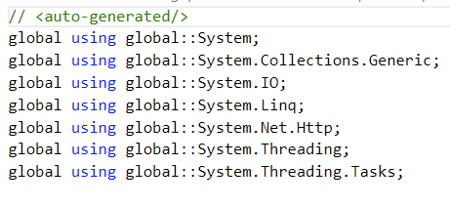
Your first C# program: however… default in .NET 8
// See https://aka.ms/new-console-template for more information
Console.WriteLine("Hello, World!");
This is a lot different because of:
Top-level statements
  No need for an explicit class Program with a static void Main method
Global usings
  The usual using statements are gathered into one file
  Have a look in your solution folder at:
  <solutionname>\<projectname>\obj\Debug\net8.0\<projectname>.GlobalUsings.g.cs
https://csharp.christiannagel.com/2020/06/30/helloworld9/

Slide 11

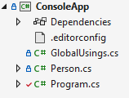
Your first C# program: however… default in .NET 8
Global usings
  Provide this option in your .csproj file
  <ImplicitUsings>enable</ImplicitUsings>
  You want to add your own global using statements applied to the project?
  3 ways:
    Add the keyword global to the using statement:
    OR add a GlobalUsings.cs file to your project with all your global using statements

Slide 12
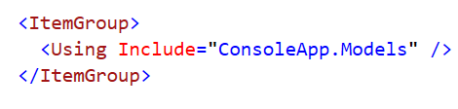
Your first C# program: however… default in .NET 8
Global usings
    OR add this to your .csproj file to add/remove implicit namespaces:

Slide 13
DATA TYPES
Java | C# | Opmerkingen
int | int | -2,147,483,648 to 2,147,483,647
long | long | -9,223,372,036,854,775,808 to 9,223,372,036,854,775,807
float | float | ±1.5e−45 to ±3.4e38, 7 precision
double | double | ±5.0e−324 to ±1.7e308, 15-16 precision
- | decimal | Financial datatype
String | string | Small s (⬄ Java)
char | char
boolean | bool | true or false

Slide 14
VARIABLE DECLARATIon – METHOD 1
int age = 38;
bool hasPassed = score >= 10;
string name = “John Doe”;
→ Same as JAVA

Slide 15
VARIABLE DECLARATIon – METHOD 2
var age = 38;
var hasPassed = score >= 10;
var name = “John Doe”;
The C#-compiler determines the correct data type
Saves space for complex data types (see conventions)
‘Can’ be useful, but this will not be standard behaviour in this course

Slide 16
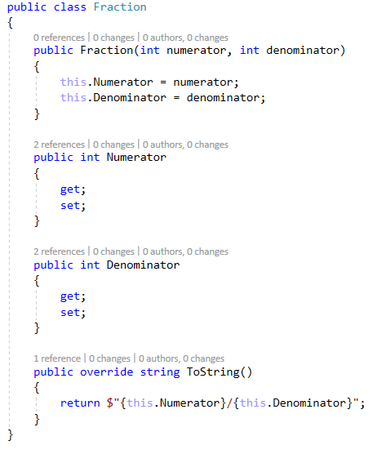
Automatic Properties
https://www.youtube.com/watch?v=o-EtDWOm56Y&list=PLhtnK9s_PXx-qveYqVaZWTYBrfpRbTGFz&index=234
Declaration of properties
with getter and/or setter
(in comparison with getXXX and setXXX methods in Java)
Convention: methods and properties are written in PascalCase (⬄ Java)

Slide 17
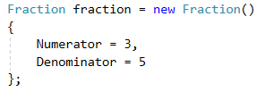
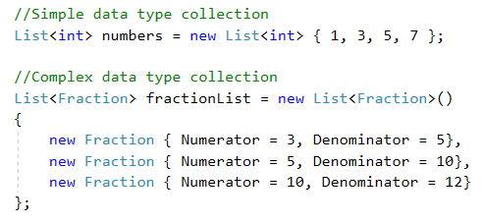
Object Initializer
http://bit.ly/2umm1Cy
Collection Initializer

Slide 18

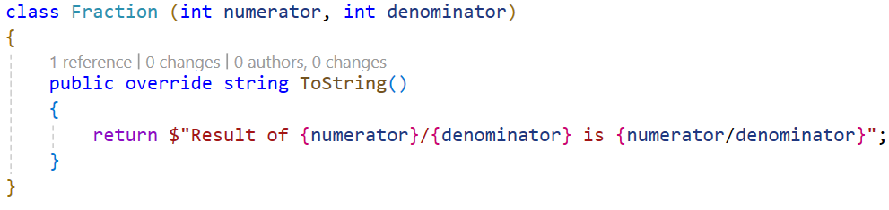
Primary constructors
Primary constructors let you define constructor parameters when you declare the class.
These parameters are automatically translated to private fields

Slide 19
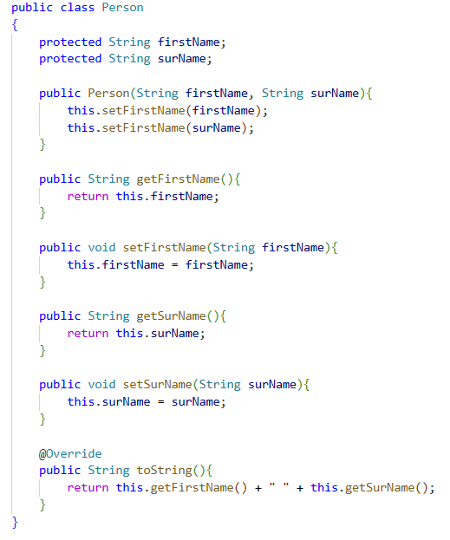
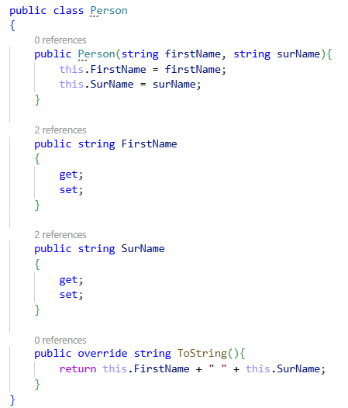
Oop IN C# - override
JAVA
C#

Slide 20
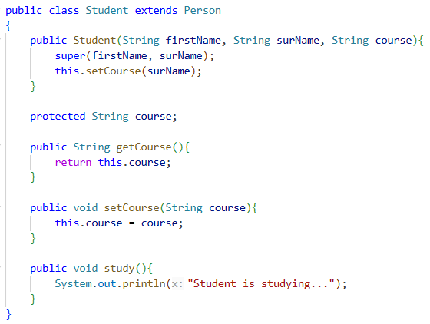
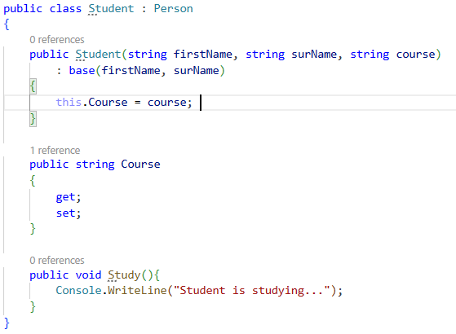
Oop IN C# - inheritance
JAVA
C#

Slide 21

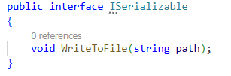
Oop IN C# - Defining INTERFACES
JAVA
C#
→ Interfaces start with a capital I (convention)

Slide 22
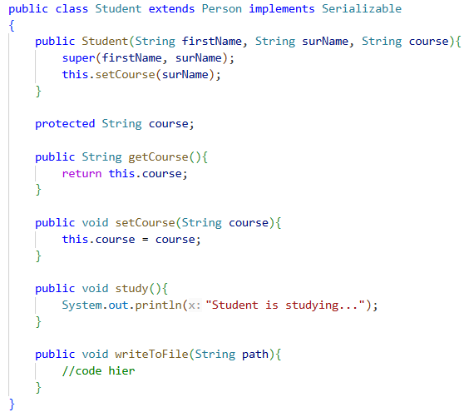
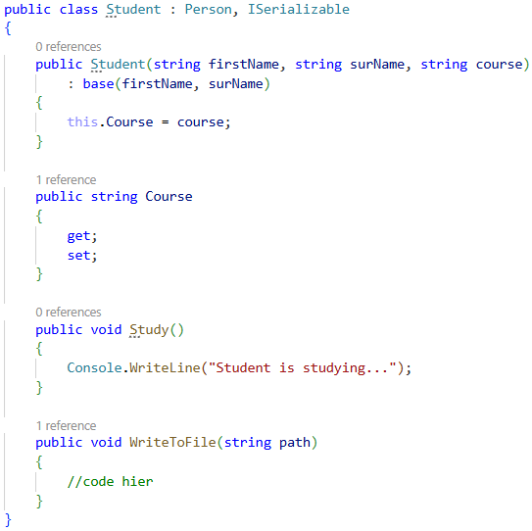
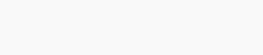
Oop IN C# - Implementing INTERFACES
JAVA
C#

Slide 23
Oop IN C# - Access modifiers
Java | C# | Opmerkingen
public | public | Accessible from everywhere
private | private | Accessible only from within the class
protected | protected | Accessible within the class and inherited classes
(1) | Internal (2) | Accessible within the assembly (3)
(1) When no access modifier is given in Java, accessibility in the same package is assumed
(2) This is the default in C# if no access modifier is specified
(3) An assembly can be seen as a .NET DLL or EXE

Slide 24
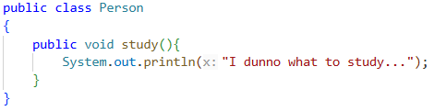
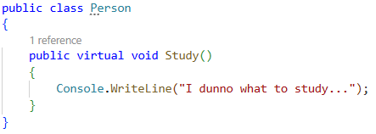
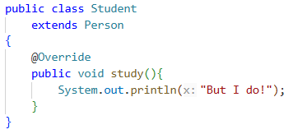
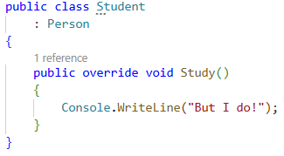
Oop IN C# - Methods and properties OVERRIDing
JAVA
C#
You can override methods and properties. Just use the modifier virtual.
In Java you don’t have to do this.

Slide 25

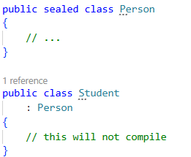
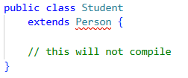
Oop IN C# - FINAL / SEALED CLASSES
JAVA
C#

Slide 26
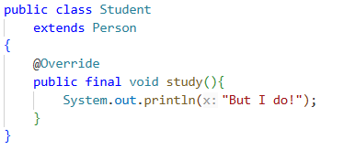
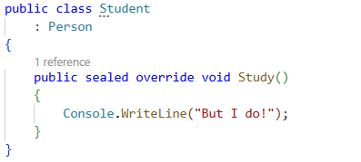
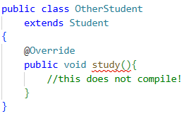
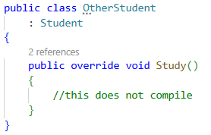
Oop IN C# - FINAL / SEALED METHODS
JAVA
C#

Slide 27
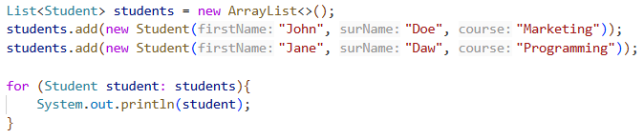
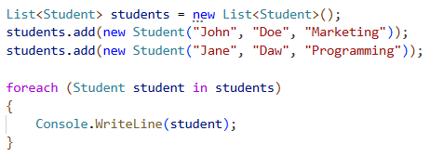
GENERIC COLLECTIONS
JAVA
C#

Slide 28
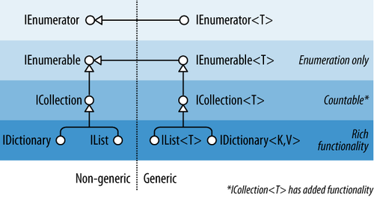
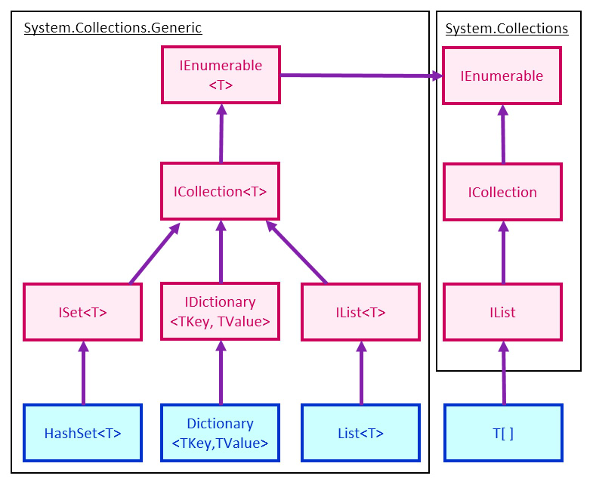
GENERIC COLLECTIONS – Interface hierarchy

Slide 29
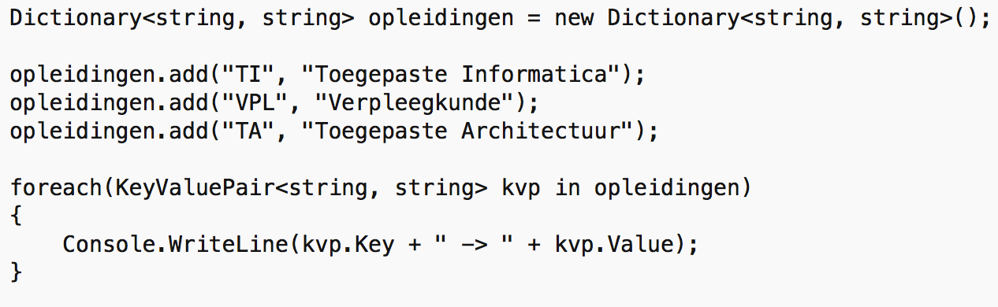
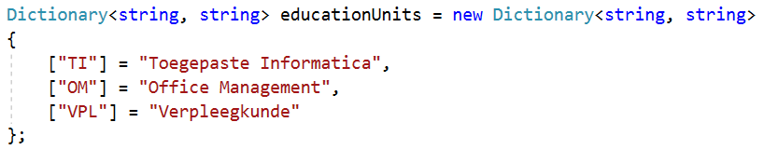
GENERIC COLLECTIONS - Dictionary
Collection Initializer

Slide 30
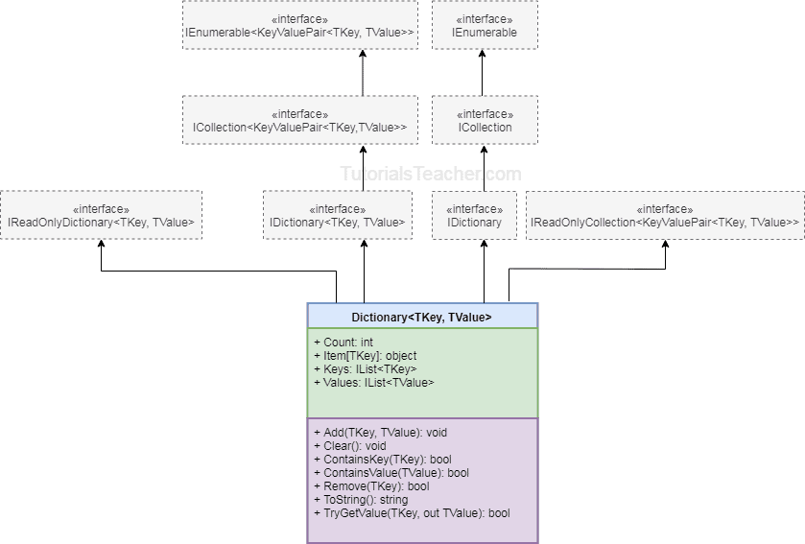
GENERIC COLLECTIONS – Interface hierarchy

Slide 31
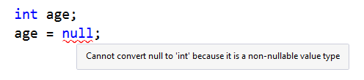
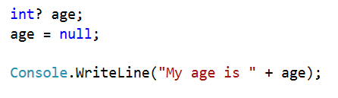
Nullable types
https://www.youtube.com/watch?v=bXsOOpWavp4&list=PLhtnK9s_PXx-qveYqVaZWTYBrfpRbTGFz&index=177
https://www.youtube.com/watch?v=NDweaZZZcbc

Slide 32
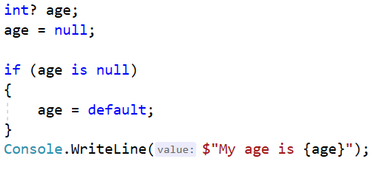
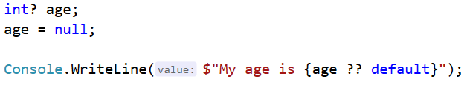
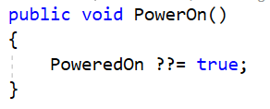
Null coalescing: ?? En ??=
https://www.youtube.com/watch?v=ZigtOlZ-bV0&list=PLhtnK9s_PXx-qveYqVaZWTYBrfpRbTGFz&index=179
https://www.youtube.com/watch?v=Ok3qXoaqrok&list=PLhtnK9s_PXx-qveYqVaZWTYBrfpRbTGFz&index=194

Slide 33


String interpolation
https://www.youtube.com/watch?v=xY4EhUdBMbo&list=PLhtnK9s_PXx-qveYqVaZWTYBrfpRbTGFz&index=176
http://bit.ly/37dv6uC
From now on NO MORE constructions like these:
USE string interpolation:
(you remember template literals in JS?)

Slide 34
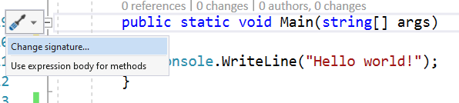
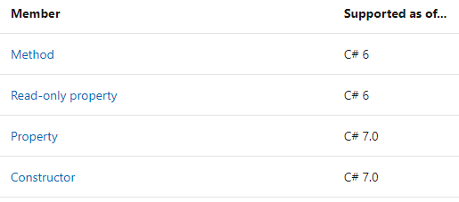
Expression-bodied members
https://www.youtube.com/watch?v=23OGtkEpMtc&list=PLhtnK9s_PXx-qveYqVaZWTYBrfpRbTGFz&index=87

Slide 35
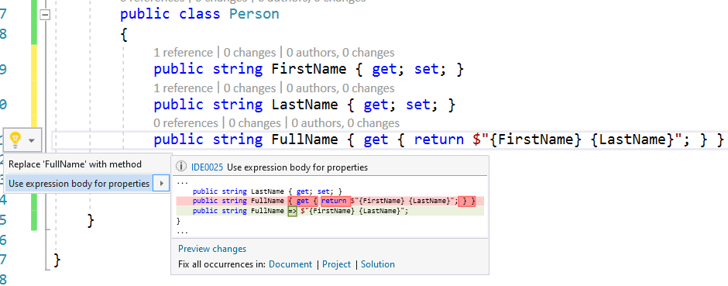
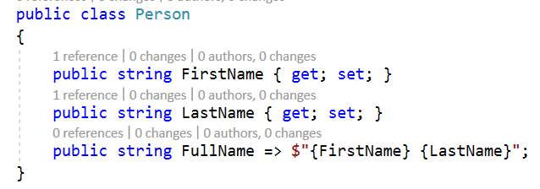
Expression-bodied members

Slide 36
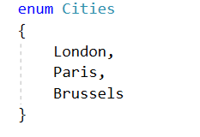
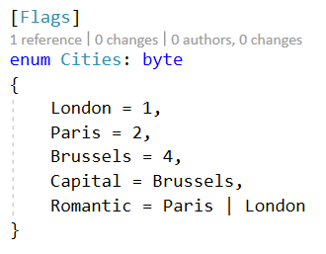
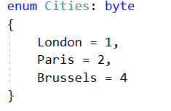
ENUM
https://learn.microsoft.com/en-us/dotnet/csharp/language-reference/builtin-types/enum

Slide 37


ENUM
Access the name of the Enum element
Access the value of the Enum element

Slide 38
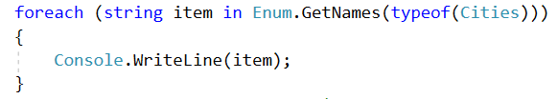



ENUM
Loop through the entire Enum
The use of the Flags attribute in the Enum

Slide 39
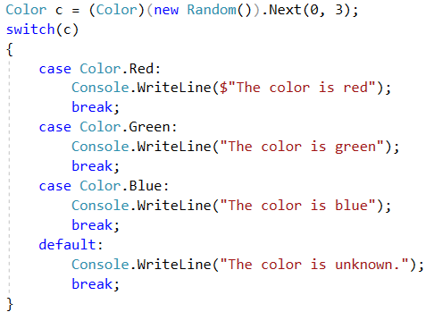
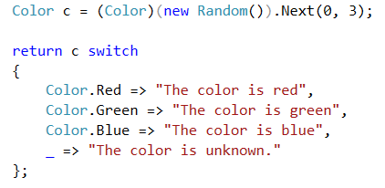
Switch Expressions
http://bit.ly/2YCwLrS
Normal switch Switch Expression

Slide 40
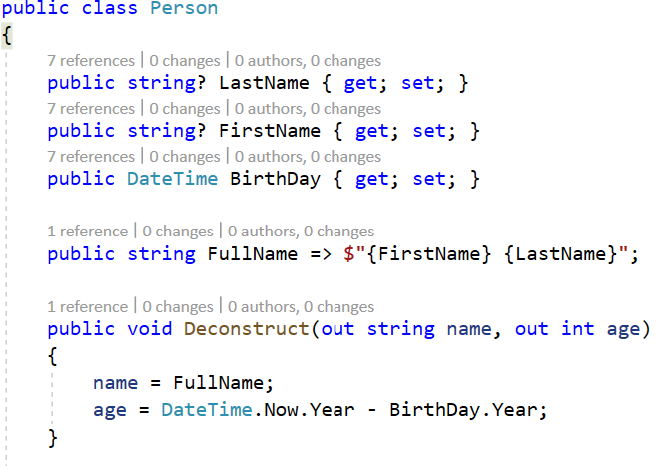
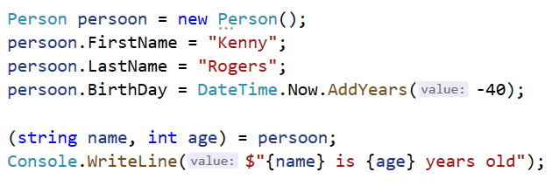
Deconstruction

Slide 41
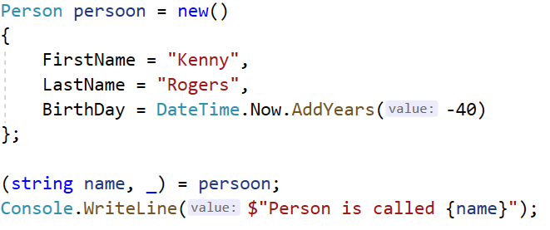

Discard
https://docs.microsoft.com/en-us/dotnet/csharp/fundamentals/functional/discards
Use the discard _ when a return value is not needed
Example 1: when using deconstruction…
Example 2: when the return value is not what you need…

Slide 42

Local function
https://www.youtube.com/watch?v=DY7DNqKKrgQ&list=PLhtnK9s_PXx-qveYqVaZWTYBrfpRbTGFz&index=182
A function within a function (= code block as a ‘call once’ function within a class)

